Slide 1
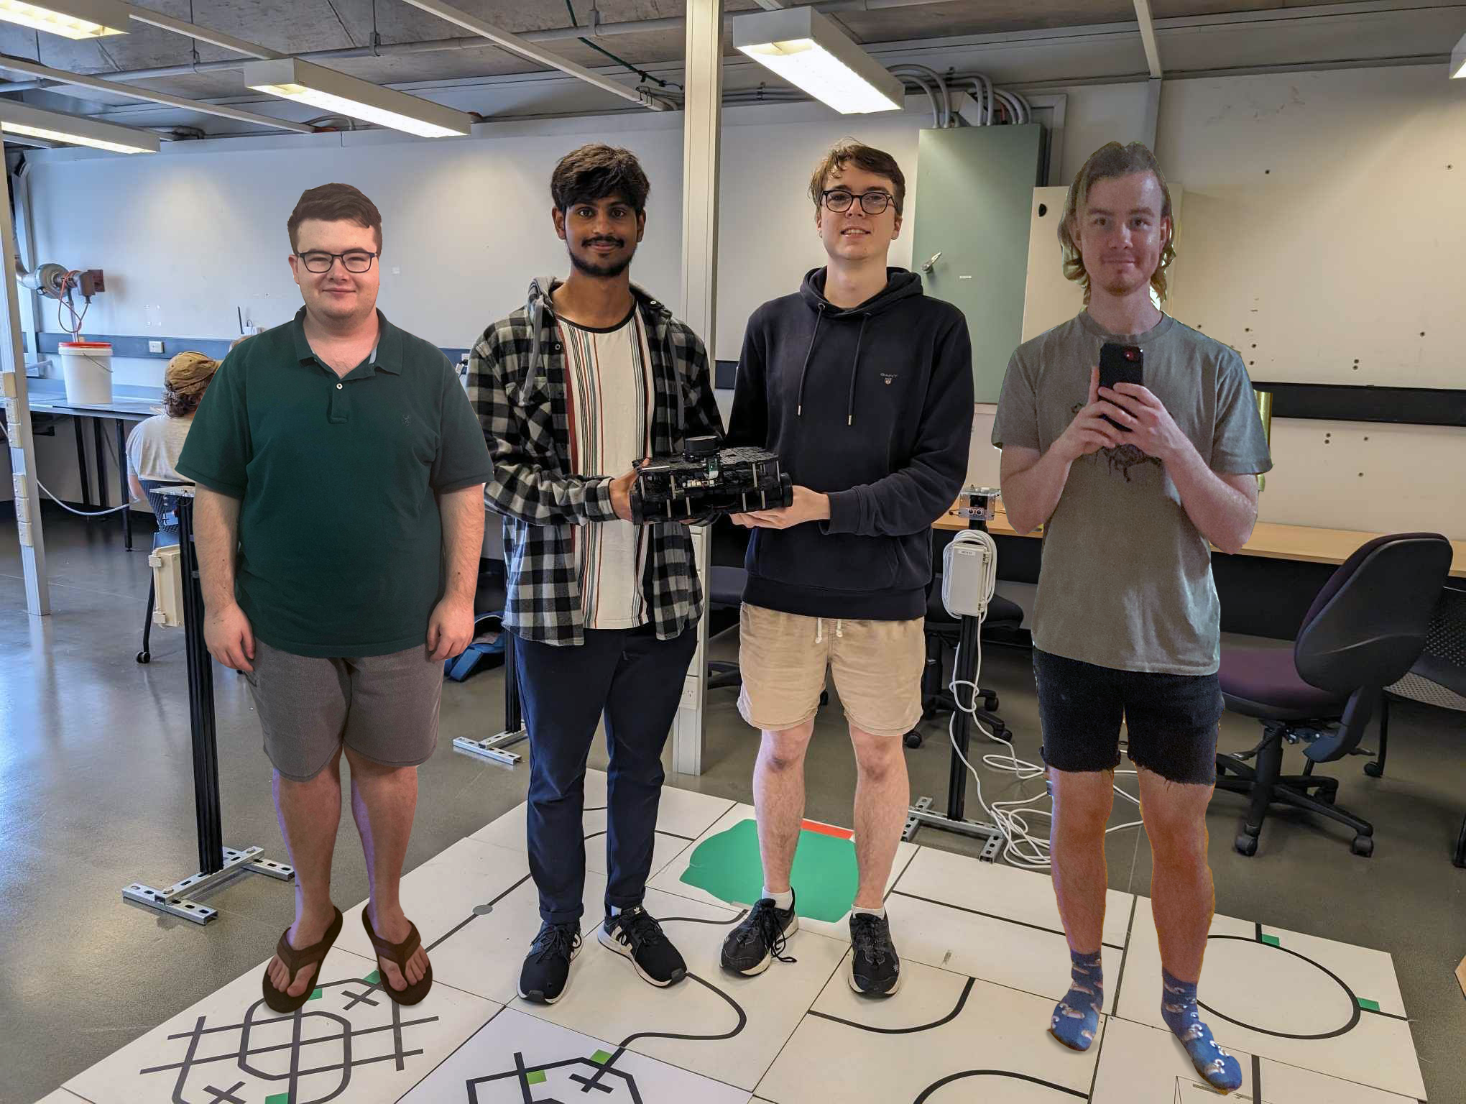
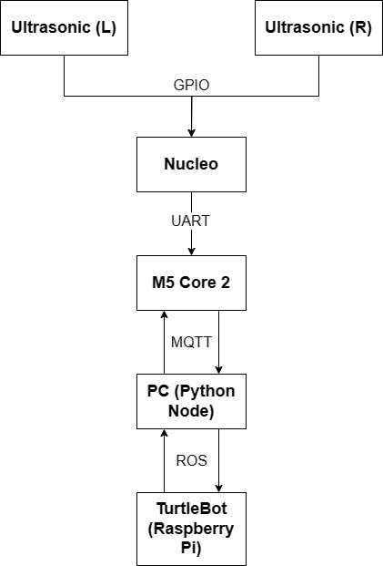
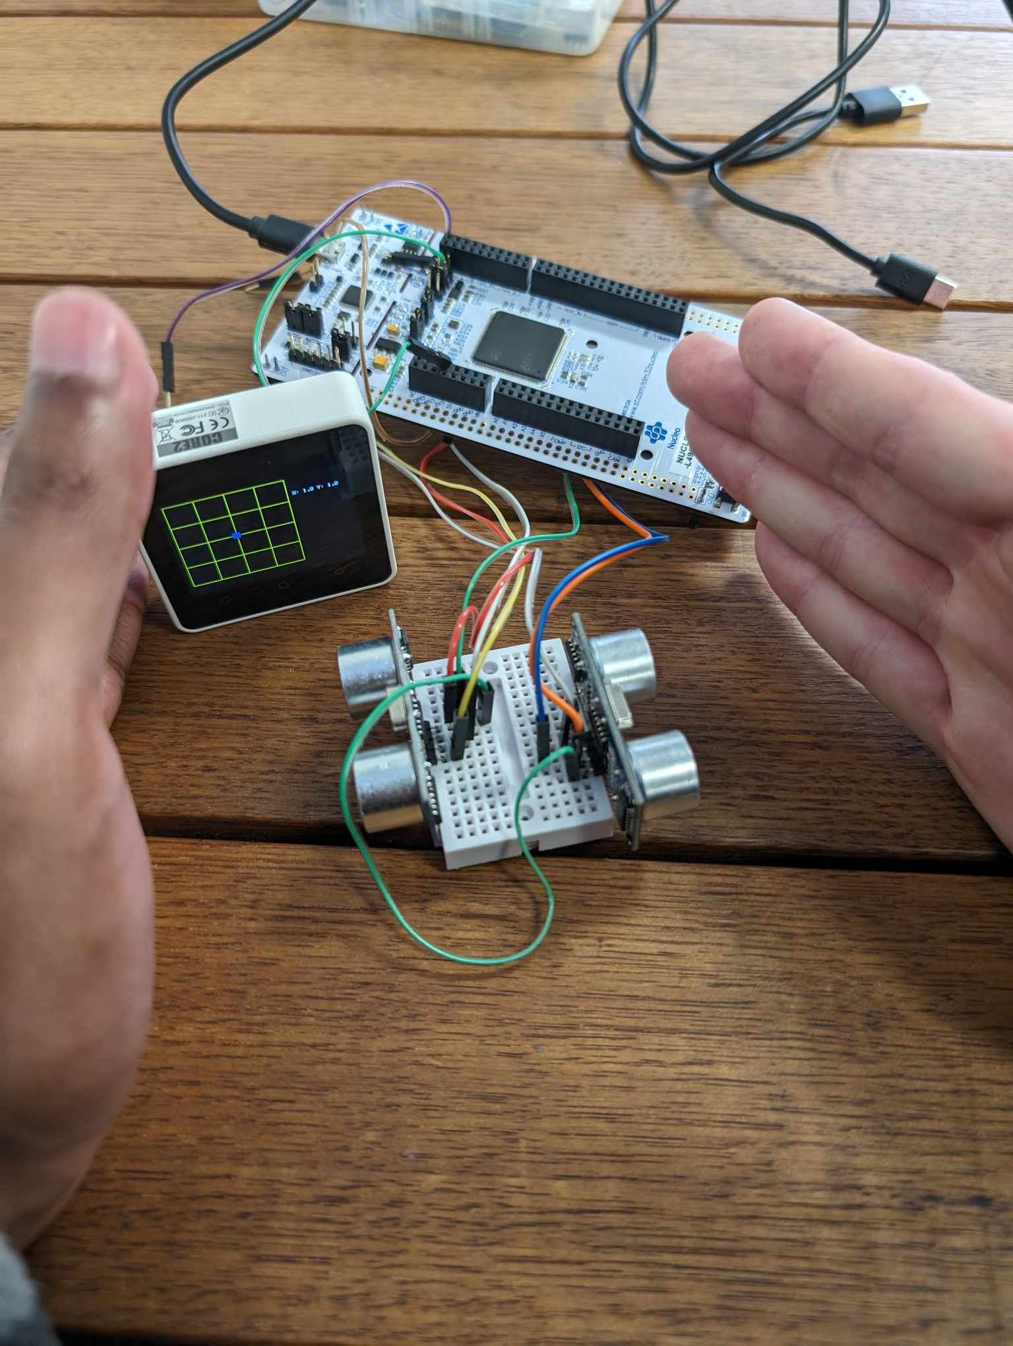
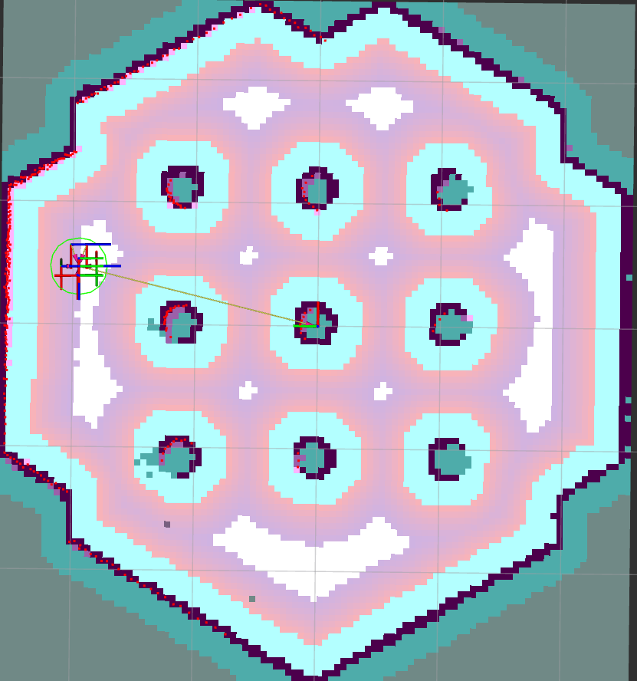
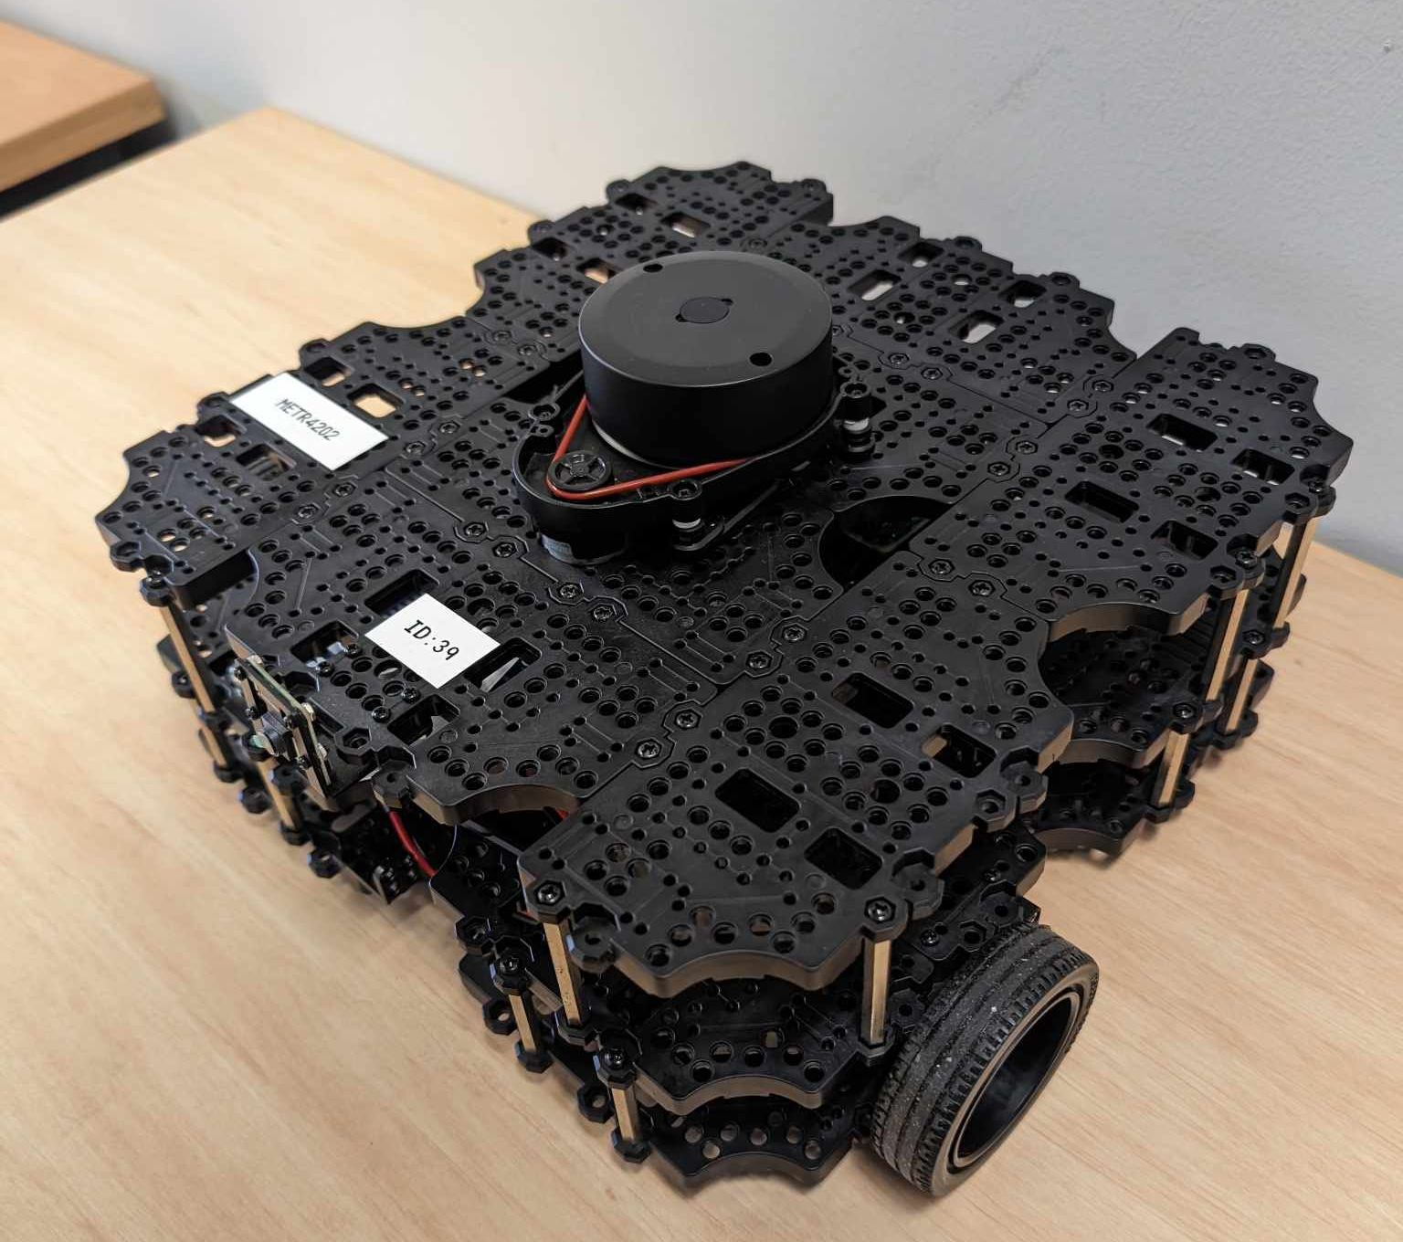
TurtleBot controlled by Ultrasonic (Variation of Fe.2)
Ethan Laskowski, Henry Sommerville, Mark Kandathiparambil, Deklan Scholler - Uranus-Crimson
SYSTEM OVERVIEW:
Controlling a TurtleBot by ultrasonic proximity
TurtleBot gesture controlled
MQTT communication between M5Core2 and remote PC node
Corresponding motion commands published from remote PC node to TurtleBot via ROS
Ultrasonic sensors connected through GPIO pins to Nucleo board
AIMS:
TurtleBot movement controlled by ultrasonic sensors, with TurtleBot linear and angular velocity controlled by proximity to US sensors
Ultrasonic sensors can be utilized as gesture controllers that affect the TurtleBot
TurtleBot’s position can be tracked and displayed on the M5Core2
TurtleBot utilizes the LiDAR to enhance position detection
LiDAR is Kalman-filtered with TurtleBot velocity to improve accuracy of localisation
TurtleBot can communicate with the M5Core2 and display its position
TurtleBot has some autonomous functionality such as turning around when it has detected it has exited a 2x2m grid
RESULTS:
TurtleBot’s motion can be controlled via the ultrasonic sensors, with its angular and linear velocity being linearly proportional to the measured distances.
Ultrasonic sensors can be used to detect gestures, and these gestures are successfully communicated to the TurtleBot whom moves accordingly
The M5Core2 can communicate to the Nucleo board via UART and the PC python node via MQTT.
PC python node can publish and subscribe via ROS network
The M5Core2 can display the TurtleBot’s position on its display.
The LiDAR can be utilized to track the TurtleBot’s position and is fused with TurtleBot velocity to improve accuracy
When reaching the grids edge the TurtleBot stops and turns
CONCLUSIONS:
To conclude, all KPIs were met with this product, as the product contains:
Successfully detection of ultrasonic distances which are processed into the correct gestures and/or the correct motion model for the TurtleBot
Successful communication of motional requirements from M5Core to PC python node via MQTT
Successful TurtleBot motion corresponding to received ROS commands, alongside moderate automation with intuitive response to moving out of bounds
Successful TurtleBot communication with M5Core (via MQTT) conveying accurate Kalman-filtered localisation estimates
Successful display of these Kalman-fused positional estimates on M5Core display.
As a result, this product is ready to be deployed in the field, either in this form, or under modification of clear and efficient reconfigurations.

